Slide 1
Introduction to the National Deaf Mental Health Service Birmingham
Service Contacts:
Day and Community Service Manager – Mandy Egan, mandy.egan@bsmhft.nhs.uk
In-Patient Service Manager – Michael Galvin, michael.galvin@bsmhft.nhs.uk

Slide 2
Who Are We?
One of three National Services providing Tertiary Mental Health Care to Deaf and Deaf-blind people
12 bedded Acute In-patient Unit
Day service
Community Service

Slide 3
Who is our service aimed at?
18+
First language BSL
Deaf-blind
Severe and enduring mental health issues
Continued ……..

Slide 4
Who is our service aimed at?
Complex needs associated with multiple developmental deprivations and psychosocial experiences, including:
Language deprivation/delay
Developmental disorder
Additional disabilities

Slide 5
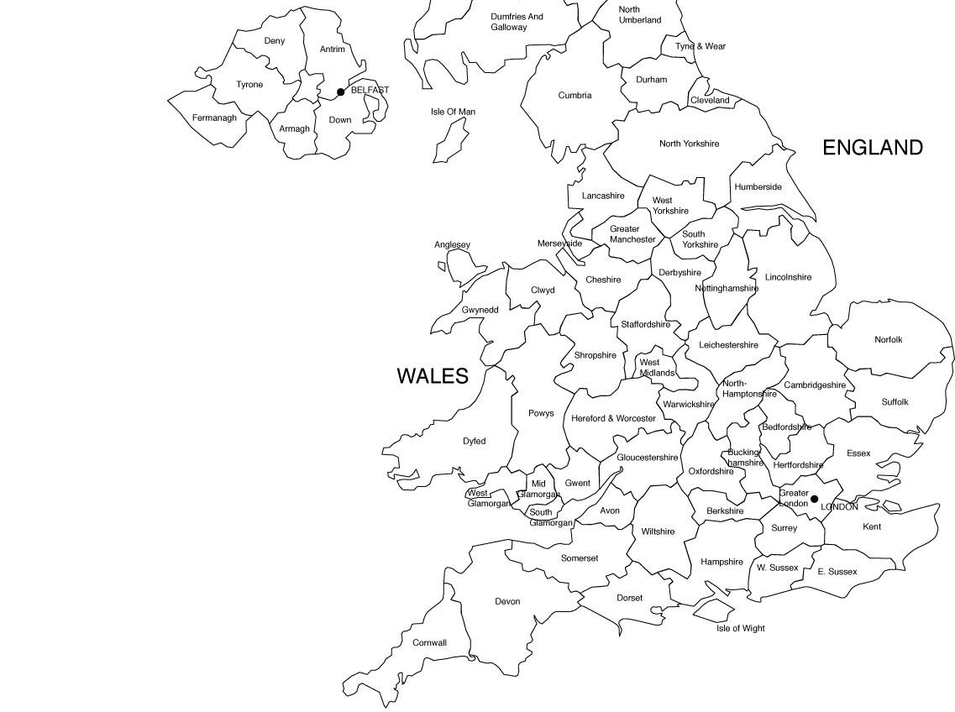
Geographical Area
Middle third of the country
Limited – Clinic only
Significantly high Deaf population

Slide 6
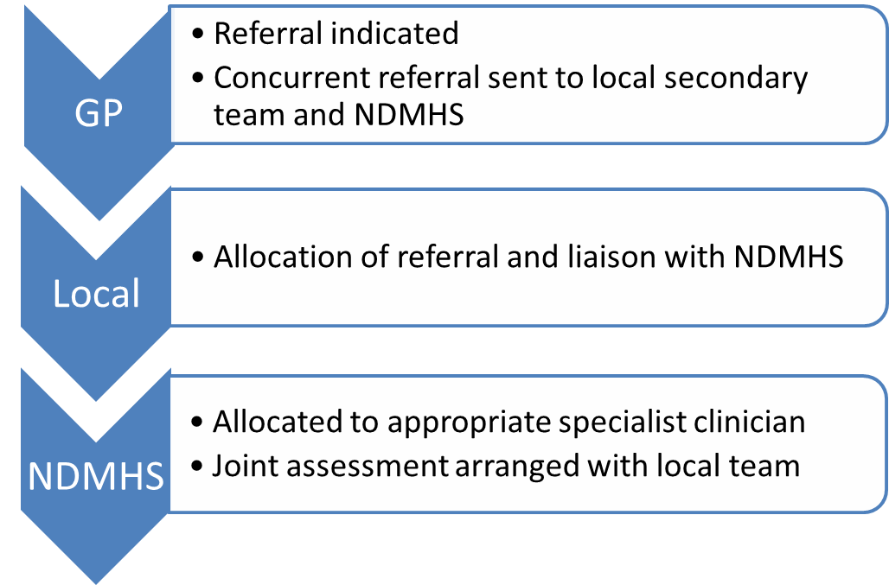
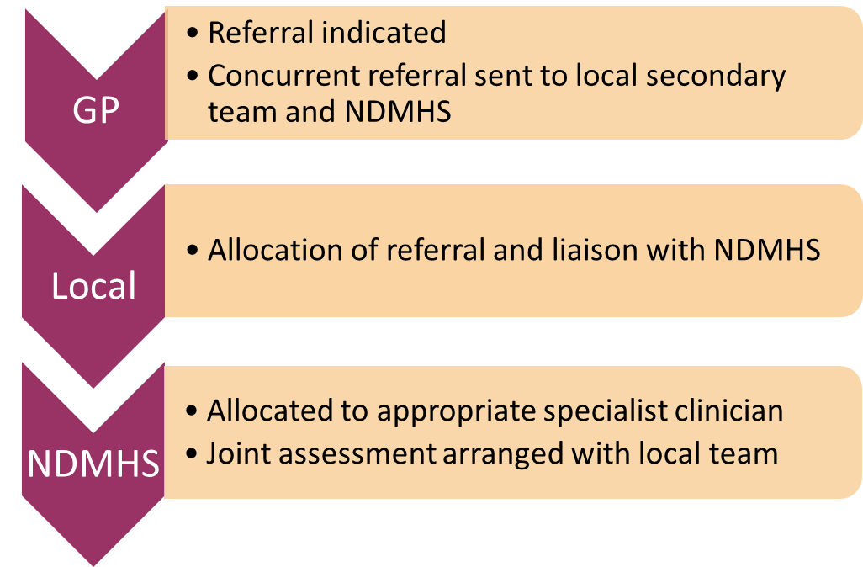
Referral Pathway

Slide 7
What We Provide
Community Assessment/
Treatment
Joint initial assessment
Liaison with local Consultant
Advice at point of review
In-patient
Assessment/
Treatment
Day
Service
Positive Deaf
Role-models
Psychological Therapies
Acute, recovery and community service models
Allied Health Professionals
Physical Health Education
Carer Support
Joint working – Home Visits
Education to local teams
1:1 and Group work
OT Assessment and recommendations
Advocacy/
Service User Forums

Slide 8
Day Service
AIM: To provide an accessible and culturally appropriate activity programme that promotes recovery and well-being through:
Group and 1:1 work
Outreach/In-reach
Education/Liaison/Signposting
Facilitates equitable access to mainstream services
Management of meds/symptoms
Continued ……..

Slide 9
Day Service (continued)
Development of language/social skills
ADLs
Green therapy
Client centred tai chi
Physical Health Education

Slide 10
Community team
AIM: To ensure equitable access to local services whilst providing additional, specialist support:
In-reach, Clinics, Home Visits
Education, support and joint-working with local CMHTs, and local specialist teams – EIS, drug/alcohol, LD
Advice on adaptation of assessment and treatment tools
Advice on potential misdiagnosis
Continued ……..

Slide 11
Community team (continued)
Working with service users to recognise symptoms and labels for emotions and feelings
Family work/Carer work; education on deafness and mental health issues
Psychological therapies; recovery, CBT, SFT
Client-centred 1:1 – limited access to group work

Slide 12
Inpatient team
AIM: To provide a culturally sensitive environment informing local care providers on Mental Health and Deafness:
Assessment of communication/language and behavioural effects
Adapted cognitive/psychological interventions
Linking with Audiology
Culturally and ergonomically appropriate environment
Continued ……..

Slide 13
Inpatient team (continued)
BSL Interpreters providing communication support to both Deaf and hearing staff
Access to Deaf-specific Advocacy
Liaison with Allied Health Professionals
Physical health wellbeing – previously unidentified and unmet needs

Slide 14
National Deaf Mental Health Service Framework
Case study 1
National Deaf Mental Health Service Framework

Slide 15
In the Beginning
Dr Margaret Du Feu
Consultant Psychiatrist

